Slide 1
Module 7: Supplementary Slides

Slide 2
Continuous Distributions: Normal Distribution: Extra Details

Slide 3
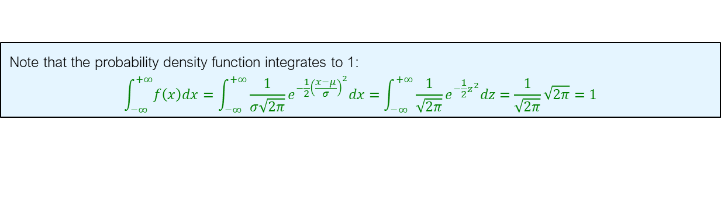

The Normal Distribution
Remark:
$$\int_{−∞}^{+∞}{e^{−x^{2}}dx}=\sqrt{π}, \int_{−∞}^{+∞}{e^{−\frac{1}{2}x^{2}}dx}=\sqrt{2π}$$
Note that the probability density function integrates to 1:
$$\int_{−∞}^{+∞}{f\left(x\right)dx}=\int_{−∞}^{+∞}{\frac{1}{σ\sqrt{2π}}e^{−{\frac{1}{2}\left(\frac{x−μ}{σ}\right)}^{2}}dx}=\int_{−∞}^{+∞}{\frac{1}{\sqrt{2π}}e^{−{\frac{1}{2}z}^{2}}dz}=\frac{1}{\sqrt{2π}}\sqrt{2π}=1$$

Slide 4
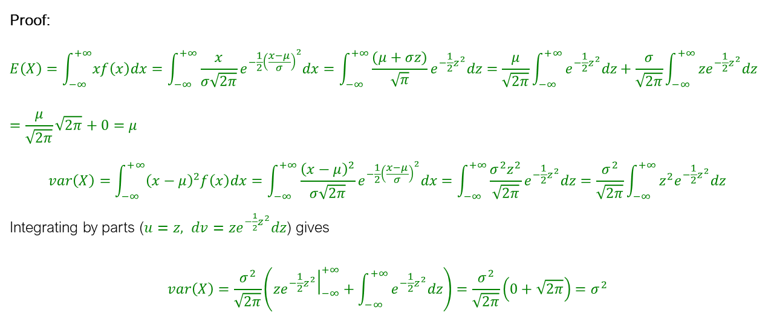
The Normal Mean and Variance
If $X$is a normal random variable with parameters $μ$ and $σ$ then
$$E\left(X\right)=μ, var\left(X\right)=σ^{2}$$
Proof:
$$E\left(X\right)=\int_{−∞}^{+∞}{xf\left(x\right)dx}=\int_{−∞}^{+∞}{\frac{x}{σ\sqrt{2π}}e^{−{\frac{1}{2}\left(\frac{x−μ}{σ}\right)}^{2}}dx}=\int_{−∞}^{+∞}{\frac{(μ+σz)}{\sqrt{π}}e^{−{\frac{1}{2}z}^{2}}dz}=\frac{μ}{\sqrt{2π}}\int_{−∞}^{+∞}{e^{−\frac{1}{2}z^{2}}dz}+\frac{σ}{\sqrt{2π}}\int_{−∞}^{+∞}{ze^{−\frac{1}{2}z^{2}}dz}=\frac{μ}{\sqrt{2π}}\sqrt{2π}+0=μ$$
$$var\left(X\right)=\int_{−∞}^{+∞}{{\left(x−μ\right)}^{2}f\left(x\right)dx}=\int_{−∞}^{+∞}{\frac{{\left(x−μ\right)}^{2}}{σ\sqrt{2π}}e^{−{\frac{1}{2}\left(\frac{x−μ}{σ}\right)}^{2}}dx}=\int_{−∞}^{+∞}{\frac{σ^{2}z^{2}}{\sqrt{2π}}e^{−{\frac{1}{2}z}^{2}}dz}=\frac{σ^{2}}{\sqrt{2π}}\int_{−∞}^{+∞}{z^{2}e^{−{\frac{1}{2}z}^{2}}dz}$$
Integrating by parts ($u=z, dv=ze^{−{\frac{1}{2}z}^{2}}dz$) gives
$$var\left(X\right)=\frac{σ^{2}}{\sqrt{2π}}\left({\left.ze^{−{\frac{1}{2}z}^{2}}\right|}_{−∞}^{+∞}+\int_{−∞}^{+∞}{e^{−{\frac{1}{2}z}^{2}}dz}\right)=\frac{σ^{2}}{\sqrt{2π}}\left(0+\sqrt{2π}\right)=σ^{2}$$

Slide 5
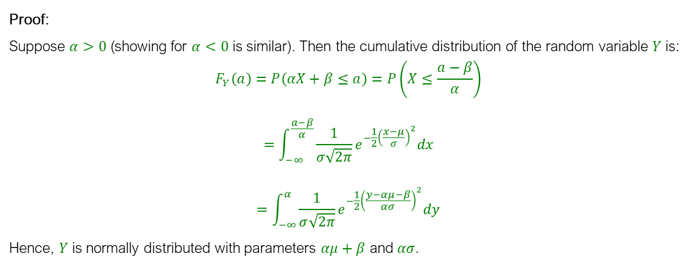
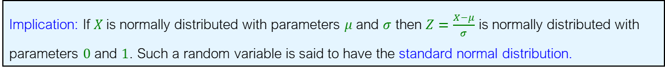

The Normal Distribution
Remark: If $X$is normally distributed with parameters $μ$ and $σ$ then $Y=αX+β$ is normally distributed with parameters $αμ+β$ and $ασ$.
Proof:
Suppose $α>0$ (showing for $α<0$ is similar). Then the cumulative distribution of the random variable $Y$ is:
$$F_{Y}\left(a\right)=P\left(αX+β≤a\right)=P\left(X≤\frac{a−β}{α}\right)$$
$$=\int_{−∞}^{\frac{a−β}{α}}{\frac{1}{σ\sqrt{2π}}e^{−\frac{1}{2}{\left(\frac{x−μ}{σ}\right)}^{2}}dx}$$
$$=\int_{−∞}^{α}{\frac{1}{σ\sqrt{2π}}e^{−\frac{1}{2}{\left(\frac{y−αμ−β}{ασ}\right)}^{2}}dy}$$
Hence, $Y$ is normally distributed with parameters $αμ+β$ and $ασ$.
(Taking $y=αx+β$)
Implication: If $X$is normally distributed with parameters $μ$ and $σ$ then $Z=\frac{X−μ}{σ}$ is normally distributed with parameters $0$ and $1$. Such a random variable is said to have the standard normal distribution.

Slide 6
Continuous Distributions: Gamma Distribution

Slide 7
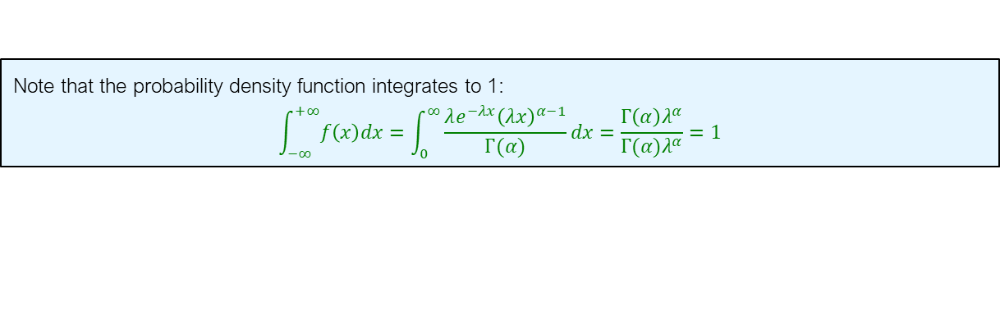
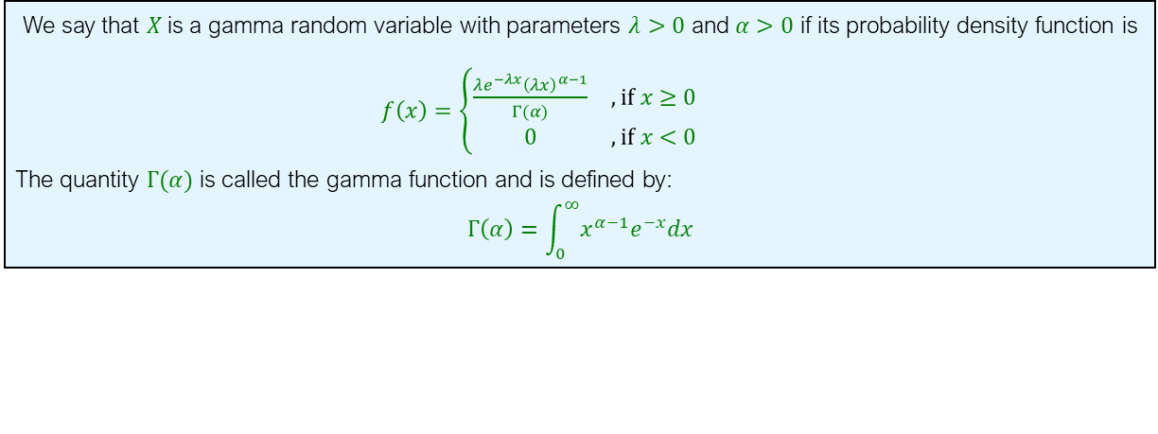

The Gamma Distribution
We say that $X$is a gamma random variable with parameters $λ>0$ and $α>0$ if its probability density function is $f\left(x\right)=\left\{\begin{matrix}\frac{λe^{−λx}{\left(λx\right)}^{α−1}}{Γ(α)} & , if x≥0 \\ 0 & ,if x<0\end{matrix}\right.$
The quantity $Γ(α)$ is called the gamma function and is defined by:
$$Γ\left(α\right)=\int_{0}^{∞}{x^{α−1}e^{−x}dx}$$
Remark:
$$\int_{0}^{∞}{x^{α−1}e^{−λx}dx}=\frac{Γ\left(α\right)}{λ^{α}}$$
Remark: It is easy to show that when $α=n$ then
$$Γ\left(α\right)=\left(n−1\right)!$$
Note that the probability density function integrates to 1:
$$\int_{−∞}^{+∞}{f\left(x\right)dx}=\int_{0}^{∞}{\frac{λe^{−λx}{\left(λx\right)}^{α−1}}{Γ(α)}dx}=\frac{Γ\left(α\right)λ^{α}}{Γ(α)λ^{α}}=1$$

Slide 8
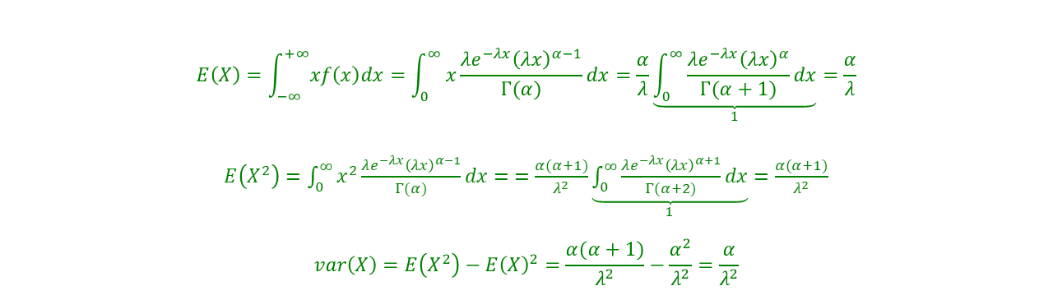
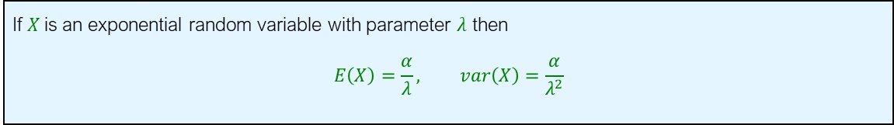
The Gamma Mean and Variance
If $X$is an exponential random variable with parameter $λ$ then
$$E\left(X\right)=\frac{α}{λ}, var\left(X\right)=\frac{α}{λ^{2}}$$
$$E\left(X\right)=\int_{−∞}^{+∞}{xf\left(x\right)dx}=\int_{0}^{∞}{x\frac{λe^{−λx}{\left(λx\right)}^{α−1}}{Γ(α)}dx}=\frac{α}{λ}\underset{1}{\underbrace{\int_{0}^{∞}{\frac{λe^{−λx}{\left(λx\right)}^{α}}{Γ(α+1)}dx}}}=\frac{α}{λ}$$
$E\left(X^{2}\right)=\int_{0}^{∞}{x^{2}\frac{λe^{−λx}{\left(λx\right)}^{α−1}}{Γ(α)}dx}=$ $=\frac{α(α+1)}{λ^{2}}\underset{1}{\underbrace{\int_{0}^{∞}{\frac{λe^{−λx}{\left(λx\right)}^{α+1}}{Γ(α+2)}dx}}}=\frac{α(α+1)}{λ^{2}}$
$$var\left(X\right)=E\left(X^{2}\right)−E{\left(X\right)}^{2}=\frac{α(α+1)}{λ^{2}}−\frac{α^{2}}{λ^{2}}=\frac{α}{λ^{2}}$$

